Slide 1


Module #2 Welcoming Your Pre-Service Teacher
Please turn on your computer’s sound and check the volume level.
The module slide presentations include voice narration and instructional videos.

Slide 2


Welcoming Your Pre-Service Teacher
Module #2

Slide 3

Welcoming Your Pre-Service Teacher
Module #2
So you’ve heard you’re getting a student teacher.
Maybe you learned this last spring or maybe you found out just today.
Either way, you’ll want to do some thinking before this person arrives.

Slide 4

The First Meeting
Module #2
Set aside time to show the Pre-Service Teacher around the school and your classroom.
Consider preparing a set of helpful documents that might include things like:
A map of the school
Class list(s)
Staff handbook/school policies
Class schedule/bell schedule
Class rules/routines

Slide 5

The First Meeting
Module #2
The first meeting between the two of you will lay the groundwork for the rest of the semester or year.
Understand that the Pre-Service Teacher will have more questions than they can even remember at this point.
Start with the basics: what time to report, work hours, their college class schedule if that applies, expected work attire, where to park, etc.

Slide 6
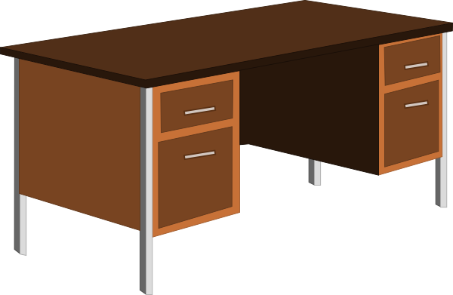

Work Space
Module #2
In classrooms at all levels, there is a significant difference between what a teacher work space looks like and what a student work space looks like.
Try to give your Pre-Service Teacher an adult work space as much like your own as possible. If there is no available adult desk, use a table. Provide a grown-up sized chair rather than a child sized chair.

Slide 7

Introducing Your Pre-Service Teacher
Module #2
Class, please welcome Mr. Phillips. He is a student teacher who will be visiting our class this year.
Class, please welcome Mr. Phillips. He is a teacher who will be working with us in our class this year.
Notice the difference?

Slide 8
Presenting the Candidate as a Teacher
Module #2
Of course you will know that the Pre-Service Teacher has less experience than you do, but the year will likely be more successful if the students understand that they now have two teachers, instead of just one.
Think about posting the candidate’s name wherever yours is posted: outside the classroom door, on the front board, near your desk, on your desk, on the class website, etc.
Mrs. Anderson
Mr. Phillips

Slide 9
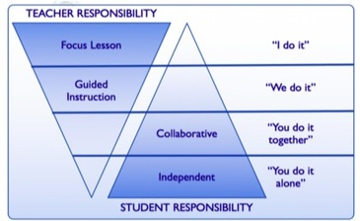
Gradual Release of Responsibility
Module #2
Cooperating Teacher
We know this works with our students.
Think about applying the same model to your work with the Pre-Service Teacher.
Pre-Service Teacher

Slide 10

Gradual Release of Responsibility
Module #2
Allow the candidate to slowly increase their role in class:
Handing out papers
Taking attendance
Assisting individual students or small groups
Designing a bulletin board
Leading the warm up
Reading aloud

Slide 11

Ask about University Program Requirements
Module #2
The early stages are the best time to ask for information about university requirements.
Is there a minimum number of “solo” teaching hours?
Is co-teaching allowed or encouraged?
Are there days when the candidate won’t be at school?
How often will we meet with the University Supervisor?
What deadlines will the candidate have that I should be aware of?

Slide 12
Ask about University Program Requirements
Module #2
Some universities have booklets or other resources for Cooperating Teachers.
edTPA is now a required part of the licensure process in OR. It is the responsibility of the pre-service teacher to complete this. You can assist to the extent you choose and/or feel comfortable. You are not expected to be a video tech guru.

Slide 13
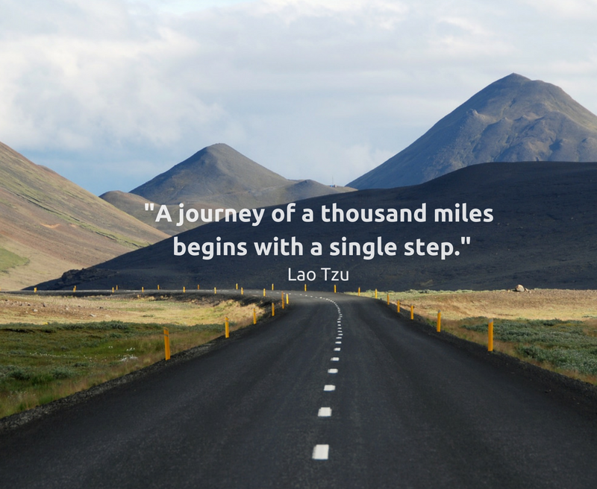
Module #2

Slide 14

First Steps
Module #2
Taking attendance
Distributing materials
Circulating and assisting students who need help
Observing the cooperating teacher (observe with a purpose)
Introducing an activity
The goal is to provide low risk opportunities for the pre-service teacher to be in front of the class and interact with students.

Slide 15

Next Steps
Module #2
Use your professional judgment to gauge when the pre- service teacher is ready to take on more responsibility.
Some will want to do more before they are ready.
Some will be reluctant even though they are more than ready.
Sometimes we need to pull back and sometimes we need to push forward.

Slide 16

Application Questions to Consider:
Module #2
Think back to the information about “Gradual Release of Responsibility.”
What do you think are some of the early responsibilities you might give the candidate and what you wait to hand off for a few weeks?
What responsibilities might be most difficult for you personally to share with the candidate.
What are some of the criteria you might be looking for to know that the candidate is ‘ready’ for more?

