Slide 1


Module #4 Characteristics of Adult Learners
Please turn on your computer’s sound and check the volume level.
The module slide presentations include voice narration and instructional videos.

Slide 2


Characteristics of Adult Learners
Module #4

Slide 3
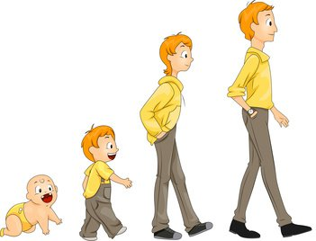
Adult Learners and Young Learners
Module #4
As classroom teachers, we are very familiar with the needs and effective practices for the level and age of our students.
But many are not nearly as familiar with the needs of adult learners.
Understanding the differences between children and adults as learners is critical to the success of our work.

Slide 4
Adult Learners
Module #4
Who is considered to be an “adult” learner?
This is someone who has achieved the concept of being responsible for their own life.
Note that some student teachers might not yet have this concept of themselves, although most probably will.

Slide 5

Young Learners
Module #4
Young Learners:
Learn in a linear manner
Are dependent on the instructor for knowledge
Are most often motivated by external factors

Slide 6

Adult Learners
Module #4
Adult Learners:
Have opinions on what they are comfortable with and where they need to put the most effort.
Will jump around and address topics out of order according to what interests them.

Slide 7
Adult Learners
Module #4
Adult Learners:
Bring their own experiences into their learning. They may have preconceived ideas that influence their choices and behaviors.
Are easily frustrated if the pace is too fast or too slow.

Slide 8
Adult Learners
Module #4
Adult Learners:
If given the tools, can self-assess and will go back over needed material without direction.
Can fill in many of their own blanks.

Slide 9
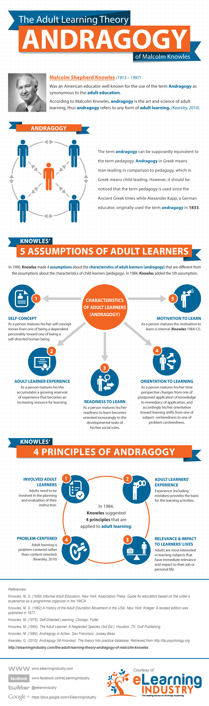
Assumptions of Adult Learners
Module #4
Researcher Malcolm Knowles developed what he called the 5 Assumptions of Adult Learners.
We will explore each of these.

Slide 10
Module #4

Slide 11
Module #4

Slide 12
Module #4

Slide 13
Module #4

Slide 14
Module #4

Slide 15

Applying this Thinking
Module #4
What does this mean for the Cooperating Teacher?

Slide 16

Applying this Thinking
Module #4
Consider these principles:
Principle 1 Make Sure to Explain the “Why”
Principle 2 When the Student is Ready, the Teacher Appears
Principle 3 Recognize and Use Personal Experience as a Resource
Principle 4 Be Mindful of High Expectations

Slide 17

Applying this Thinking
Module #4
Principle 1 Make Sure to Explain the “Why”
Adults are often very busy and usually are not interested in learning just for the sake of learning. They expect to understand why they need particular learning or how they will use specific information in the near future.

Slide 18
Applying this Thinking
Module #4
Principle 1 Make Sure to Explain the “Why”
The cooperating teacher’s language might sound like:
“It’s helpful to place students in a seating chart on the first day in order to learn their names more quickly.”
“Let’s lesson plan together so that if either of us is absent, the other one will know exactly what to teach.”

Slide 19
Applying this Thinking
Module #4
Principle 2 When the Student is Ready, the Teacher Appears
“When the student is ready, the teacher appears,” is an old saying packed with wisdom. If your student teacher is not ready to learn something, no matter how hard you may try, it just won’t work.
Look for clues that might indicate a student teacher is ready for a next step.

Slide 20
Applying this Thinking
Module #4
Principle 2 When the Student is Ready, the Teacher Appears
You might hear things like the following from your student teacher:
“How did you know to reteach that part of the lesson?”
“I wonder if they understood my directions.”
“I’m not sure what to do if they ask a question I don’t know the answer to.”

Slide 21

Applying this Thinking
Module #4
Principle 3 Recognize and Use Personal Experience as a Resource
Student teachers, as adult learners, bring a wealth of life experience with them to your classroom. They will learn best and most willingly when allowed to make use of this experience during new learning.

Slide 22
Applying this Thinking
Module #4
Principle 3 Recognize and Use Personal Experience as a Resource
Cooperating teacher language might sound like,
“You’ve probably encountered difficult people in your life, and a challenging student behaves the same way. Direct confrontation is usually not received very well.”
“Just like in our personal relationships, being honest and authentic is important to establishing trust in the classroom.”

Slide 23

Applying this Thinking
Module #4
Principle 4 Be Mindful of High Expectations
In the hands of an experienced educator, teaching often looks easy. This can be disconcerting to a student teacher who tries to replicate what the cooperating teacher is doing only to find that things don’t go nearly as well. Many novice educators have very high expectations for themselves and are devastated by their early results in the classroom.

Slide 24
Applying this Thinking
Module #4
Principle 4 Be Mindful of High Expectations
It is also possible for us, the experienced teachers, to set our expectations too high for someone just beginning in the classroom. It is important to remember that student teachers have a lot to learn during their time with you.

Slide 25
Applying this Thinking
Module #4
Principle 4 Be Mindful of High Expectations
We suggest giving smaller, easier tasks at the beginning and building to more complex assignments. For example, student teachers would likely feel comfortable circulating and helping individual students before they felt ready to teach a mini lesson.

Slide 26


In Contrast
Module #4
Young Learners:
Learn in a linear manner
Are totally dependent on the instructor for knowledge
Are motivated by external pressures
Adult Learners:
Want to decide which topics to focus on
Bring their experiential knowledge into a learning environment
Will self-assess if given the proper tools

Slide 27

Questions to Consider:
Module #4
Think about the unique characteristics of adult learners.
What specific words or actions do you think you can include in your mentoring that honors your candidate as an adult learner?

